Slide 1
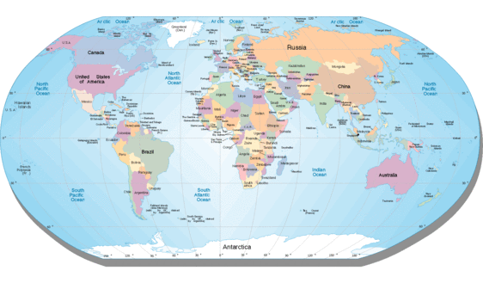
Global TCM Standards Organisations
Founding Principals of inclusion for Non Medical and Medical practitioners by –
WHO Guidelines on Acupuncture Training; World Federation of Chinese Medicine Societies (WFCMS); World Federation of Acupuncture-Moxibustion Societies (WFAS). SATCM; State Administration of TCM
Notes:
Professional

Slide 2
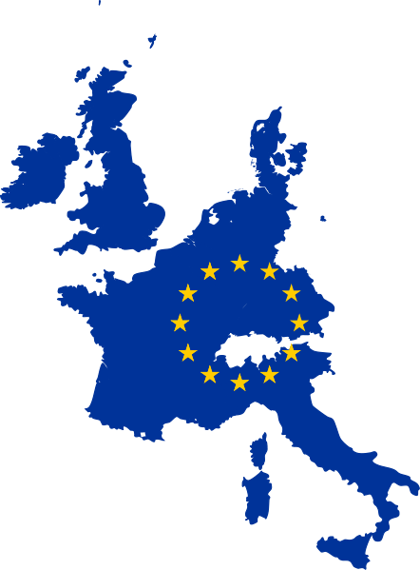
Strong EU Demand for Treatments
In Ireland, the UK and the English speaking world .CAMbrella (2012), This is reflected in a similar steady and constant demand reported across the EU Ernst & White (2000), WHO(2005), DOHC (2002), DOHC (2005). CAMbrella (2012)

Slide 3
Public Safety and Sector Discrimination
The CAM sector in Ireland has no formal or legal status, no registration of therapists, or recognition of their qualifications, and no official oversight on their training and practice. This lack of recognition and professional status is replicated in the UK, EU and most of the western world.

Slide 4
No Regulation or Government support
Despite consumer choice Acupuncture and CM in most of the EU remains unregulated and unsupported by successive governments ,. Budd & Mills (2000 Pg 8). No national registers of adequately trained practitioners - citizens in Ireland and the EU must search for competent and safe practitioners ,. CAMbrella(2012).

Slide 5
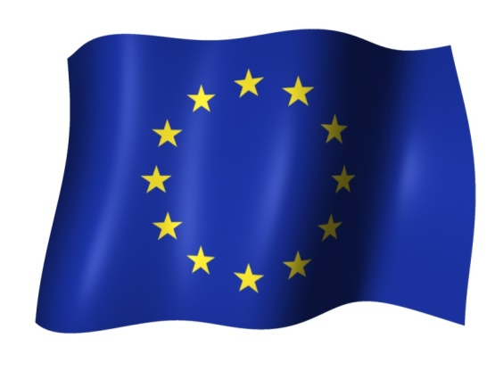
EU has a “hands off” approach
NO EU guidance to member states on possible structure or framework options for sector regulation and practice - noted in the CAMbrella Report to the EU (2012).

Slide 6
Eu Resolution 1997
EU called for a process of developing structures for recognising non- conventional medicines.
Contradicted by the EU Treaties of Rome and Lisbon which stated that “each member state has the responsibility for their own health policies.
No willingness to harmonise regulatory structures within EU.

Slide 7
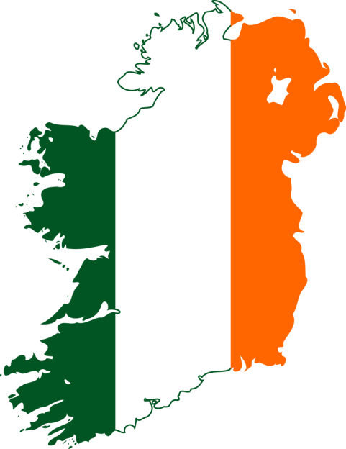
Irish Government Initiatives
The period between 2001 and 2006 was the most active for Irish government initiatives into CAM therapies.
2003 – 2006 and a National Working Group on the Regulation of CAM Therapists published recommendations for regulation. DOHC (2002, Pg 5).
No action on recommendations.

Slide 8
Opposition to CAM(ACU-CM)Regulation
Opposition by the biomedical healthcare sector to any government recognition of CAM therapies. Efforts to restrict, obstruct or reduce the levels of recognition for CAM therapies are common not only in Ireland but in many countries in the EU and elsewhere. Vasquez (2006 P2)

Slide 9
Adult Learners _ No recognition?
Notes:
Discrimination against a whole section of the community in Ireland which is typical of many European countriesAgainst principles of OECD, UNESCO. And United Nations principles of individual choice.

Slide 10
Recognition of Acu/CM/CAM
Notes:
* Asian countries such as China, Korea and Japan are not included in this study as there is an acceptance and integration of Eastern and Western healthcare choices within these countries.

Slide 11
Recent European changes
Hungary / Slovenia Medical doctors only -
Portugal – New CAM Regulation – Not Healthcare – treatments taxed.
Switzerland – Government Recognition and equal status to medical doctors. Included in healthcare.

Slide 12
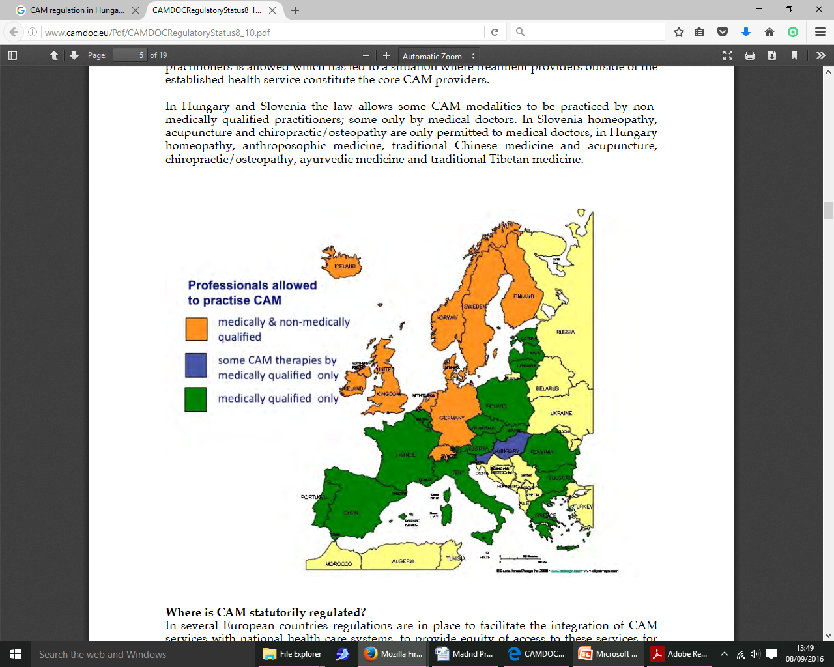
Notes:
CAMbrella CAMdoc.

Slide 13
Excluded as healthcare professionals
Acupuncture/CM - Models of regulation - limited options as we as outside of what some call the orthodox healthcare sector.

Slide 14
Notes:
Professional regulation, not a perfect solution, but fills the regulation vacuum. No government support, no government oversight.

Slide 16
Patients are confused

Slide 17
What does the sector say they need. Ward (2014)

Slide 18
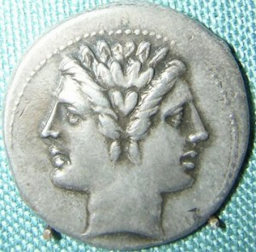
Regulation and Progress 2 sides of the same coin
We cannot have progress as Acupuncture and Chinese Medicine
Professionals without a regulatory structure
Notes:
We can no longer have progress as healthcare professionals, if we do not work within a regulatory model. Models of regulation are for us limited options as we as acupuncturists and Chinese Medicine professionals are outside of what some call the orthodox healthcare sector.

Slide 19
1. Statutory regulation, government support, protects and embraces the discipline.
National registration,
Protection of title,
Practitioner status,
Inclusion in healthcare planning and budgets,
Inclusion in healthcare delivery to the public.
Defined as “Authorised Health Professionals by the EU”
Notes:
Gold standard of regulatory models.

Slide 20
Voluntary Self Regulation does not provide
National register of practitioners
Protection of title,
Inclusion in wider healthcare sector (planning, budgets, delivery)
Exclusion from taxation of treatments.
Notes:
Subjective, open to abuse, no quality oversight, few checks and balances

Slide 21
Best of both worlds the big C
CROMPROMISE
Notes:
A better more progressive working model would be. Voluntary professional regulation, within a governmental structure, underpinned by legislation.

Slide 22
Progressive Voluntary Regulatory Model
“Light touch” regulation,
Self funded by the professions,
No financial pressure on budgets, and would provide
National Register of practitioners.
Protection of Title
Access to government healthcare programmes
Academic validation of training courses
in higher education.
Designation as EU authorised health professionals.
–
Notes:
It is in all of our interests to support our national efforts to achieve a progressive model of regulation. Much early work has been done in many countries by the first practitioners and the groups they formed. There is considerably more work to do.

Slide 23
Support our national efforts
PEFOT member countries need the active support of the federation. Activate PEFOTS policies to support members regulatory efforts.
Notes:
If the best most progressive regulatory model for acupuncture and Chinese Medicine in our own countries is government support and protected Voluntary Regulation, it wont happen by itself.

Slide 24
PEFOTS Pan European Federation of TCM Societies
Through an active representative organisation like PEFOTS we can all help each other in our national battles.
Notes:
National regulation has a wider significance. We all work within Europe, so our regulatory models must be national with reference to the EU, as recommendations for change can come from the EU

Slide 25
Bernadette Ward, PhD, Education) Dublin City University. Irl MSc, (Traditional Chinese Medicine) Middlesex University, UK Lic. Ac, Dip Herbs, (AFI - Nanjing University)
Vice President PEFOTS. Chair, PEFOTS Education Committee.
Email: bwardafi@hotmail.com
www.bernadetteward.com

